Slide 1
8.2 Arrays
Arrays and iteration

Slide 2
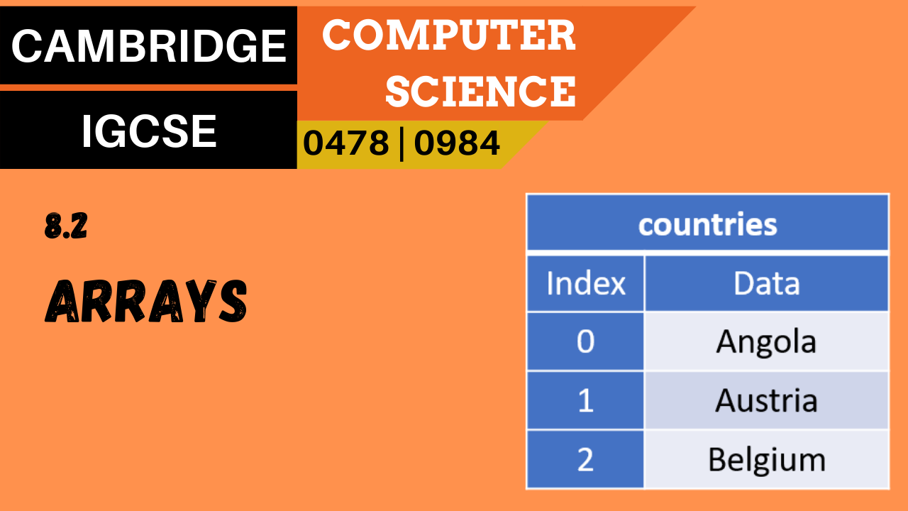

A note about this video
This video describes how to write values into and read values out from an array using iteration.
It assumes you have already watched and are comfortable with the content of the previous video, 8.1 The use of arrays.

Slide 3
Arrays and iteration
countries
Index | Contents
0 | Angola
1 | Austria
2 | Belgium
3 | Canada
An array can contain a lot of separate data items, and it is often necessary to travel through all these elements:
Populating an entire array
Traversing an array to find/update an item
Outputting the contents of an array
Luckily, there is an ideal programming construct to support this – iteration, or FOR loops.
countries
Index | 0 | 1
0 | Angola | 1246700
1 | Austria | 83871
2 | Belgium | 30528
3 | Canada | 4280915

Slide 4
Arrays and iteration
Here we are using a FOR loop to populate the test scores of ten students into a one-dimensional array.
DECLARE TestScores : ARRAY[0:9] OF INTEGER
FOR Counter ← 0 TO 9
OUTPUT "Enter the next test score: "
INPUT TestScores[Counter]
NEXT Counter
TestScores
Index | Contents
0 | 47
1 | 56
2 | 12
3 | …
4
5
6
7
8
9
Note: Each element is referenced by its index number. IGCSE pseudocode tends to use [1] as the first index, but many languages use [0].
Output window:
Enter the next test score: 47
Enter the next test score: 56
Enter the next test score: 12
...

Slide 5
Arrays and iteration
Here we are using a FOR loop to output the contents of the TestScores array.
DECLARE TestScores : ARRAY[0:9] OF INTEGER
FOR Counter ← 0 TO 9
OUTPUT "Test score ", Counter + 1, ": ", TestScores[Counter]
NEXT Counter
TestScores
Index | Contents
0 | 47
1 | 56
2 | 12
3 | 19
4 | 100
5 | 45
6 | 78
7 | 40
8 | 58
9 | 92
Output window:
Test score 1: 47
Test score 2: 56
Test score 3: 12
Test score 4: 19
...

Slide 6
Arrays and iteration
Here we are using a nested FOR loop to populate the lowest and highest marks of ten students into a two-dimensional array.
DECLARE TestScores : ARRAY[0:9, 0:1] OF INTEGER
FOR CounterX ← 0 TO 9
OUTPUT "Student ", CounterX +1
OUTPUT "Enter low score followed by high score"
FOR CounterY ← 0 TO 1
OUPUT "Input score: "
INPUT TestScores[CounterX, Counter Y]
NEXT CounterY
NEXT CounterX
TestScores
Index | 0 | 1
0 | 13 | 89
1 | 19 | 73
2 | 11 | 95
3 | … | …
4
5
6
7
8
9
Output window:
Student 1
Enter low score followed by high score
Input score: 13
Input score: 89
Student 2
Enter low score followed by high score
Input score: 19
Input score: 73

Slide 7
Arrays and iteration
Here we are using a single FOR loop to output the contents of the TestScores array.
DECLARE TestScores : ARRAY[0:9, 0:1] OF INTEGER
OUTPUT "No. Low High“
OUTPUT "============="
FOR Counter ← 0 TO 9
OUTPUT Counter + 1, " ",TestScores[Counter,0], " ", TestScores[Counter,1]
NEXT Counter
Output window:
TestScores
Index | 0 | 1
0 | 13 | 89
1 | 19 | 73
2 | 11 | 95
3 | 13 | 37
4 | … | …
No. Low High
=============
1 13 89
2 19 73
3 11 95
4 13 37
...

Slide 8


